Slide 1
Election Forecasting with Online Polling Data
Evidence from Dalia Europulse Survey
Alexander Sacharow | Moritz Hemmerlein
October 10, 2017

Slide 2
Outline
Intro to Election Forecasting: Methods
State of the Art Polling
Employing Dalia Data: Our Methodology
Our Forecasts
Take Aways

Slide 3

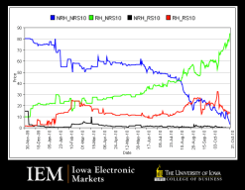






Election Forecasting: Methods
Fundamental Models
Polling / Surveys
Wisdom of the Crowd
Markets, Competitions, Aggregated Forecasts
Vote = f (politics, economics)
e.g. Party popularity
e.g. GDP
Digital Trace Models
Combining Forecasts
Hybrid Models

Slide 4
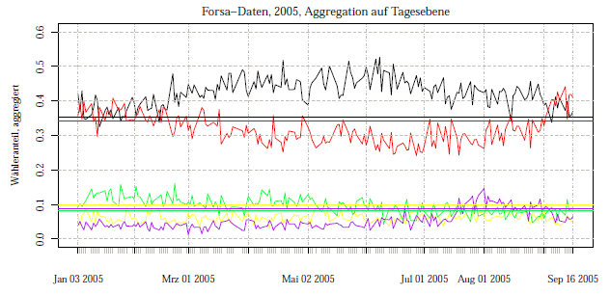
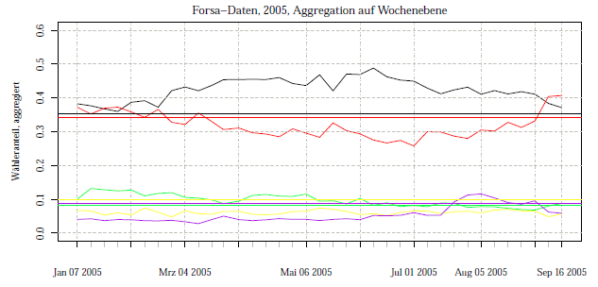
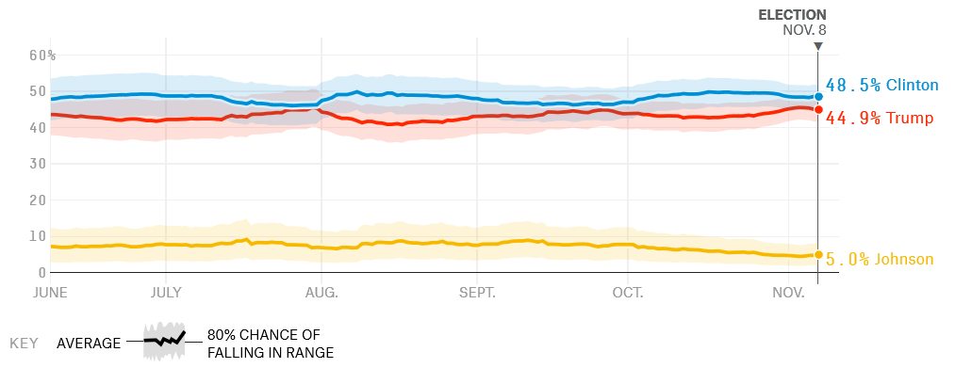
Polling: Extracting the signal
Single polls can vary strongly
Noise due to simple sample variation
Uncertainty often not representated
Tendency to horse race journalism
Reporting any change of party support
Statistical standard errors are ignored

Slide 5

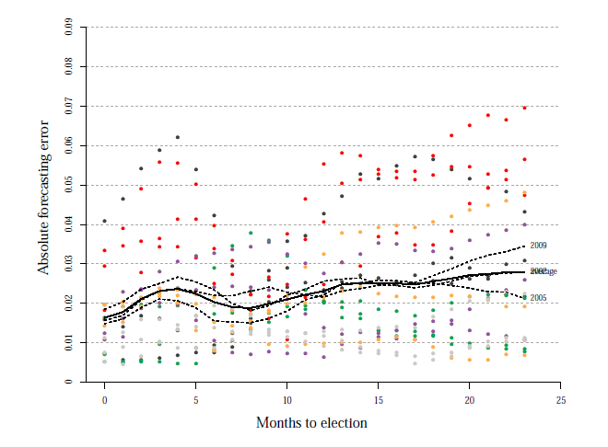
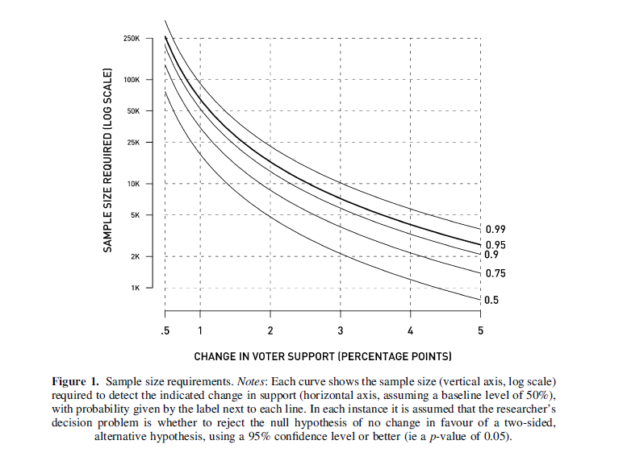
Polling: Accuracy and Confidence
Generally: Accuracy increases as elections approach
But: Campaign noice before elections
More accurate polls 8 months before actual election
Most election polls are based on small samples (n=1000)
Showing robust change in voter support is difficult

Slide 6
Polling: Collection vs. Analytics
Mandatory Response e.g. Census
Random Person e.g. House-door
Raking
Marginal Distribution
RDD e.g. IntraTest
Data
Post-stratification Combined Distribution
Data Collection
Analytics
Sub-Sample Panel e.g. YouGov
Model-based Post-Stratifcation Logistic Regression
Pre-Stratification e.g. DaliaResearch
Response „on Street“ e.g. zeit.de
Notes:
Considerations
decreasing response rates
realized samples are biased
Approach
realize (massive) non-representative poll
collect predictive demographic dimensions (sex, race, age, education, state, party ID, ideology, previous vote)
statistically adjust for bias using multilevel-regression with poststratification (MRP)

Slide 7
Adjusting Europulse Data: Methodology
Data
Combined probabilities: explained
Surveys:
Europulse Wave December 2016 and March 2017
Variables: last vote, next vote
Post-stratification: two variations
1. Census 2011 with gender, age and religion
2. Exit-polls with age, gender and vote (combined probabilities)
Benchmark data:
Aggregated polls from Sueddeutsche
 | Catholic | Protestant | Total
Men | ? | ? | 7
Women | ? | ? | 13
Total | 17 | 3 | 20
 | Catholic | Protestant | Total
Men | 6 | 1 | ∑
Women | 11 | 2 | ∑
Total | ∑ | ∑ | ∑

Slide 8
Adjusting Europulse Data: Methodology
Post-stratification approach
Weights Calculation
Combined distribution of demographics: age, gender, education, rural/urban, religion etc…
Weights for every cluster: e.g. Women above 60 from rural settlement
4% of population, but only 2% in sample
→ Weight: 2
DALIA POLL | SPD | CDU | Total
Men | 2 | 8
Women | 6 | 5
Total
EXIT POLL | SPD | CDU | Total
Men | 4 | 6
Women | 4 | 7
Total
General problems of post-stratification
Exponential growth of clusters:
Small cluster (n<30) => large errors
Empty cluster => no weights
Ad hoc solution: Combining categories (e.g. merge age categories)
Weight: MEN+SPD = 2

Slide 9
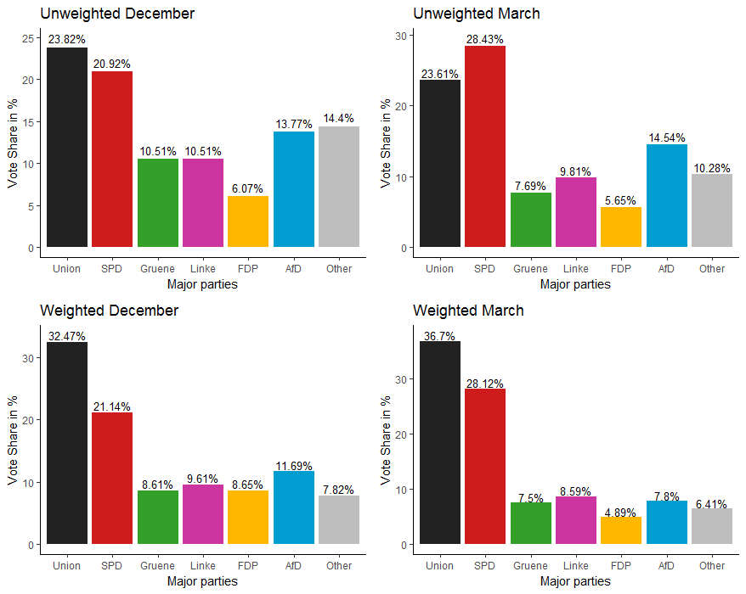
Adjusting Europulse Data: Results

Slide 10
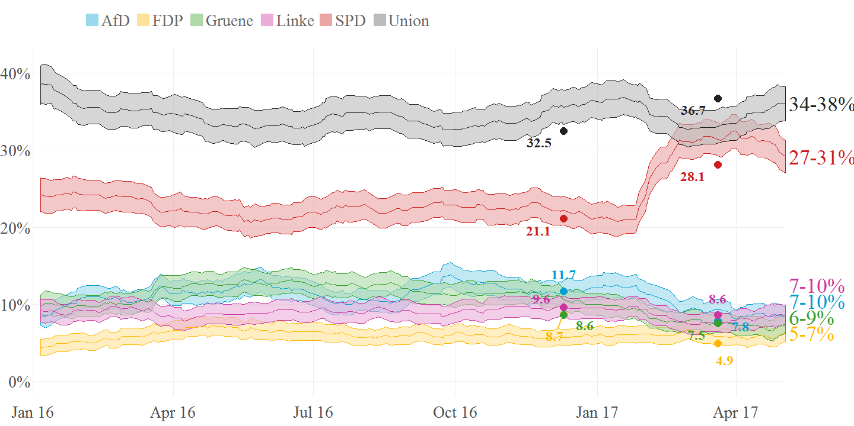
Adjusting Europulse Data: Results
=> Post-stratification with publicly available exit polls lead to quite good results compared to benchmark data

Slide 11
Adjusting Europulse Data: Take aways
Pre-stratification not sufficient for election polling
(likely voter)
Post-stratification with past-vote is promising
1.
2.
No improvements from census-only post-stratification
Further fine-tuning: Disaggregated data + more waves
3.
4.

Slide 12
Papers and Sources
Bernstein, Robert, Chadha Anita, and Robert Montjoy. 2001. “Overreporting Voting: Why It Happens and Why It Matters.” Public Opinion Quaterly 65: 22–44.
Dalia Research. 2016. “Dalia Research Methodology.” https://daliaresearch.com/wp-content/uploads/2016/08/Methodology-PDF-1.pdf.
Gallup. 2010. “Understanding Gallup’s Likely Voter Models.” http://www.gallup.com/poll/143372/understanding-gallup-likely-voter-models.aspx?version=print.
Gelman & King 1993. „Why are american presidential campaign polls so variable when votes are so predictable?, British Journal of Political Science 13(04), pp. 409 – 451.
Goel, Sharad, Adam Obeng, and David Rothschild. 2017. “Online, Opt-in Surveys: Fast and Cheap, but Art They Accurate?” Working Paper.
Jackman, Simon. 2005. “Pooling the Polls over an Election Campaign.” Australian Journal of Political Science 40 (4): 499–517. doi:10.1080/10361140500302472.
Keeter, Scott, Ruth Igielnik, and Rachel Weisel. 2016. “Can Likely Voter Models Be Improved? Evidence from the 2014 U.S. House Elections.” Pew Research Center.
Keeter, Scott, Courtney Kennedy, Michael Dimock, Jonathan Best, and Peyton Craighill. 2006. “Gauging the Impact of Growing Nonresponse on Estimates from a National Rdd Telephone Survey.” The Public Opinion Quarterly 70 (5): 759–79. http://www.jstor.org/stable/4124225.
Linzer 2013. “Dynamic Bayesian Forecasting of Presidential Elections in the States”, Journal of the American Statistical Association 108(501): 124 – 134.

Slide 13
Papers and Sources
Mellon, Jonathan, and Chris Prosser. 2015. “Investigating the Great British Polling Miss: Evidence from the British Election Study.” SSRN Electronic Journal. doi:10.2139/ssrn.2631165.
Murr 2011. “’Wisdom of crowds’? A decentralized election forecasting model that uses citizens’ local expectations”. Electoral Studies 30 (2011) 771-783.
Perry, Paul. 1960. “Election Survey Procedures of the Gallup Poll.” Public Opinion Quaterly 24:
Pew Research Center. 2012. “Assessing the Representativeness of Public Opinion Surveys.” Pew Research Center. http://www.people-press.org/2012/05/15/assessing-the-representativeness-of-public-opinion-surveys/.
Rothschild 2015. “Combining forecasts for elections: Accurate, relevant, and timely”. International Journal of Forecasting, 31 (2015) 952-964.
Skibba, Ramin. 2016. “The Polling Crisis: How to Tell What People Really Think.” Nature 538 (7625): 304–6. doi:10.1038/538304a.
Squire, Peverill. 1988. “Why the 1936 Literary Digest Poll Failed.” The Public Opinion Quarterly 52 (1): 125–33. http://www.jstor.org/stable/2749114.
Wang, Wei, David Rothschild, Sharad Goel, and Andrew Gelman. 2015. “Forecasting Elections with Non-Representative Polls.” International Journal of Forecasting 31 (3): 980–91. doi:10.1016/j.ijforecast.2014.06.001.
Yeager, D. S., J. A. Krosnick, L. Chang, H. S. Javitz, M. S. Levendusky, A. Simpser, and R.Wang. 2011. “Comparing the Accuracy of Rdd Telephone Surveys and Internet Surveys Conducted with Probability and Non-Probability Samples.” Public Opinion Quarterly 75 (4): 709–47. doi:10.1093/poq/nfr020.

Slide 14
Q&A
What can be the role of election forecasting for Dalia?

Slide 15
APPENDIX

Slide 16

Digital Trace Models
Twitter:
Idea: # of mentioning
Some successes (Tumasjan et al. 2010)
But:
Not replicable (Jungherr et al. 2012)
Twitter usage very low, in particular in Germany
Wikipedia
Idea: Information seeking before election
Tested by Yasseri and Bright (2016) for European Elections
Little insight into absolute vote outcomes
Good information about changes in both overall turnout at elections
Google Search
Idea: Compare # of searches of parties / candidates
Result: Good measure of public attention
Fields of applications
Influenza incidence
E.g. Google Flu Trends
But relation broke down
Product sales
E.g. Books, films
Stock markets
Online follows market and not the otherway
Elections

Slide 17
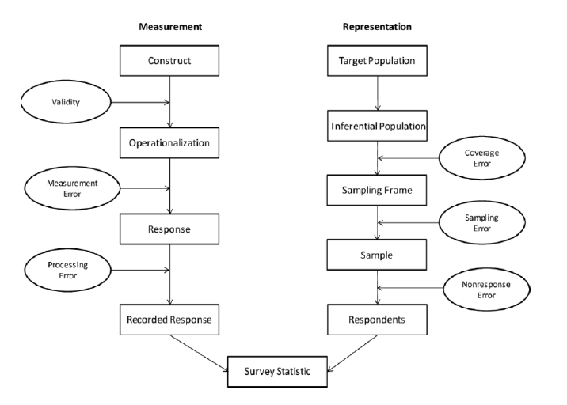
Sources of Error

Slide 18
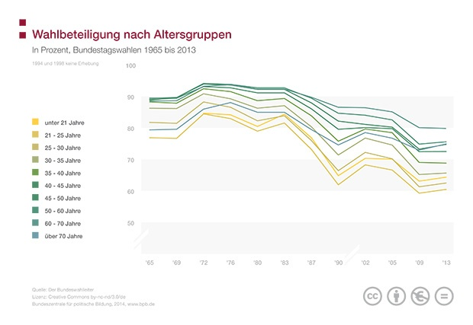
Turnout

Slide 19
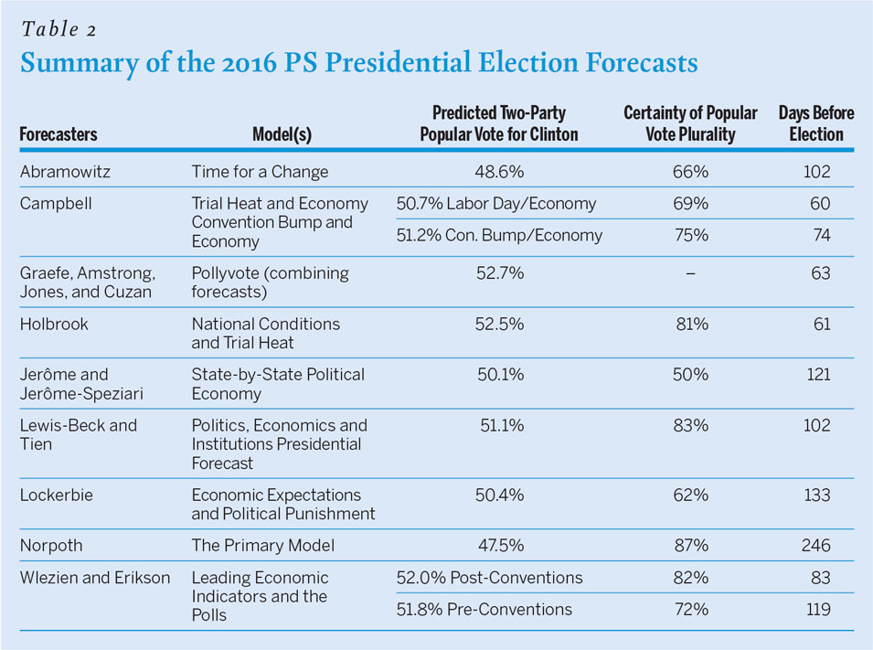
Statistical Models
Example
Kanzlermodell by Gschwend und Norpoth (2010)
STIM = –5,93 + 0,75 × (PAR) + 0,38 × (KAN) – 1,52 × (AMT)
STIM: Stimmenanteil der Regierungsparteien bei einer Bundestagswahl
PAR: Langfristige Parteiunterstützung (Mittel der Stimmenanteile der Regierungsparteien bei den letzten drei Bundestagswahlen)
KAN: Kanzlerunterstützung (Mittelwert, unter Ausschluss von Unentschlossenen, ein und zwei Monate vor der Wahl)
AMT: Amtsperiode der Regierung

